Slide 1
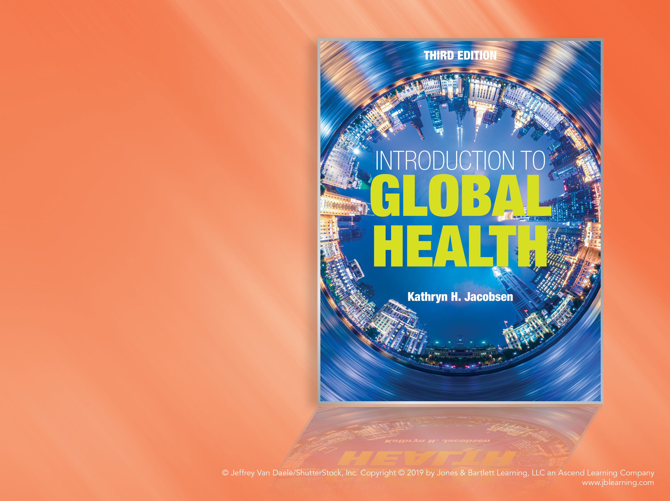
Chapter 8
HIV/AIDS and Tuberculosis

Slide 2
HIV/AIDS, TB, and Global Health
8.1

Slide 3
The “Big 3”
The global response to HIV/AIDS in the 1990s (and beyond) launched modern global health.
HIV/AIDS, tuberculosis (TB), and malaria are among the infections that cause the most deaths worldwide each year.
  Different agents, modes of transmission, prevention methods, and treatment options exist.
  All require the financial, technical, and operational support of dozens of different players through partnerships like the Global Fund.

Slide 4
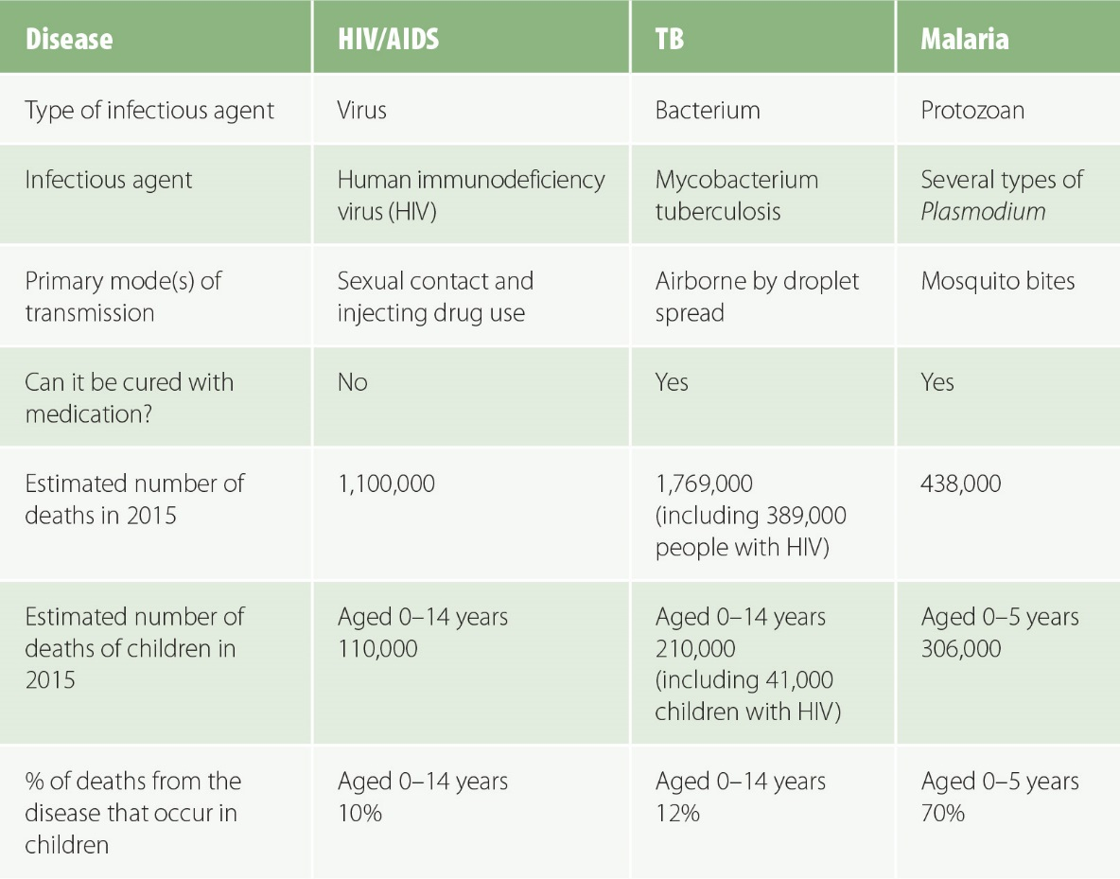
Figure 8-1
Data from AIDS by the numbers 2016. Geneva: UNAIDS; 2016. Global tuberculosis report 2016. Geneva: WHO; 2016. World malaria report 2015. Geneva: WHO; 2015.
Comparison of HIV/AIDS, TB, and malaria.

Slide 5
Viruses, Bacteria, and Fungi
8.2

Slide 6
Viruses, Bacteria, and Fungi
There are many different types of pathogens that can cause infection, including viruses, bacteria, fungi, and parasites.
Virus = a piece of nucleic acid (DNA or RNA) encased in a shell that can replicate only by invading the cells of a living host and taking control of the cells’ nuclei; the human body will clear most acute viral infections on its own, but some viruses become chronic infections.
Bacterium = a single-celled prokaryotic organism; most are harmless, but some are pathogenic; most can be cured with antibiotic drugs.
Fungus = a eukaryotic organism like a mold or yeast; antifungal medications can treat some fungal diseases.

Slide 7
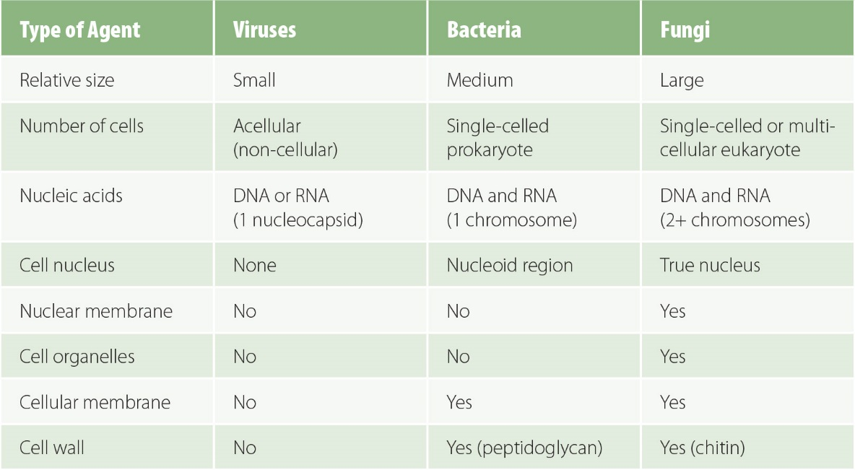
Figure 8-2
Comparison of viruses, bacteria, and fungi.

Slide 8
HIV and AIDS
8.3

Slide 9
HIV and AIDS
Human immunodeficiency virus (HIV) = a viral infection.
Acquired immunodeficiency syndrome (AIDS) = illnesses occurring as a result of the destruction of immune system cells by the HIV virus.
  Sign = an objective indicator of disease that can be clinically observed, such as a rash, cough, fever, or elevated blood pressure.
  Symptom = a subjective indication of illness that is experienced by an individual but cannot be observed by others, such as a headache, stomachache, pain, or fatigue.
  Syndrome = a collection of signs and symptoms that occur together.
HIV is contagious, because it is a transmissible virus; AIDS is not contagious, because it is a syndrome related to HIV infection and it is not an infectious agent.

Slide 10
CD4 Cells and Viral Counts
HIV destroys specialized white blood cells that are needed by the immune system to fight infection, especially CD4 cells, also called T-cells or CD4+ T-helper cells, which are lymphocytes that have a CD4 glycoprotein on their surfaces.

Slide 11
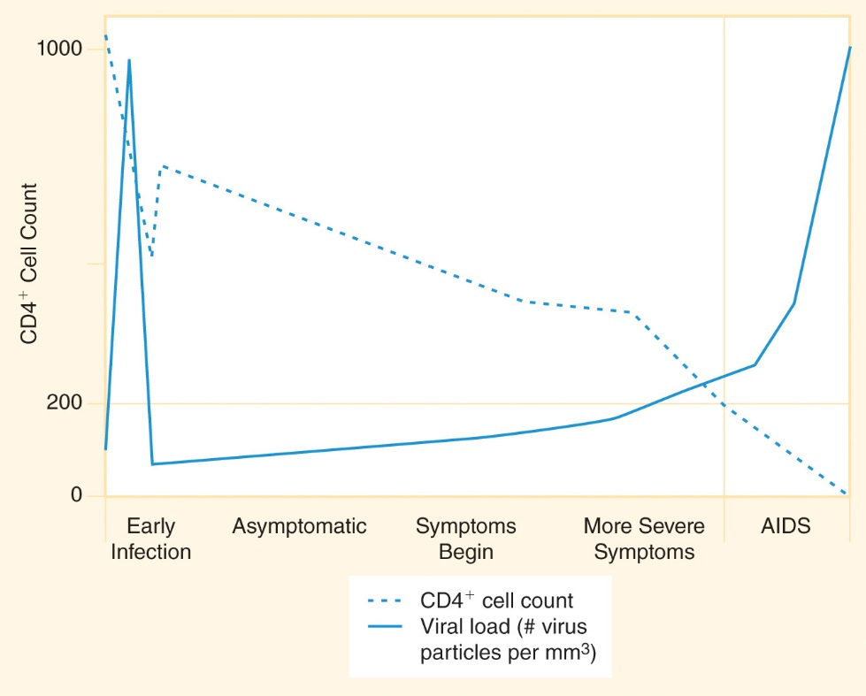
Figure 8-3
CD4+ cell count and viral load following HIV infection.

Slide 12
Staging
Primary infection = a person newly infected with HIV may experience flulike symptoms for a few days or weeks but is often asymptomatic.
WHO identifies four clinical stages of HIV infection and AIDS disease that follow primary infection.
  Stages 1 and 2 = asymptomatic or only minor symptoms.
  Stage 3 = more severe symptoms like recurrent infections; the CD4 count begins to fall and the viral load in the blood begins to rise.
  Stage 4 = serious opportunistic infections mark the onset of AIDS; the CD4 count becomes very low.

Slide 13
Opportunistic Infections
Opportunistic infections (OIs) = the constellation of diseases that occur in people with AIDS when the body’s immune system is weakened enough to give the infectious agents an opportunity to invade.
Examples: TB, bacterial pneumonia, Pneumocystis carinii pneumonia (PCP), chronic diarrhea, and fungal infections such as Cryptococcus.

Slide 14
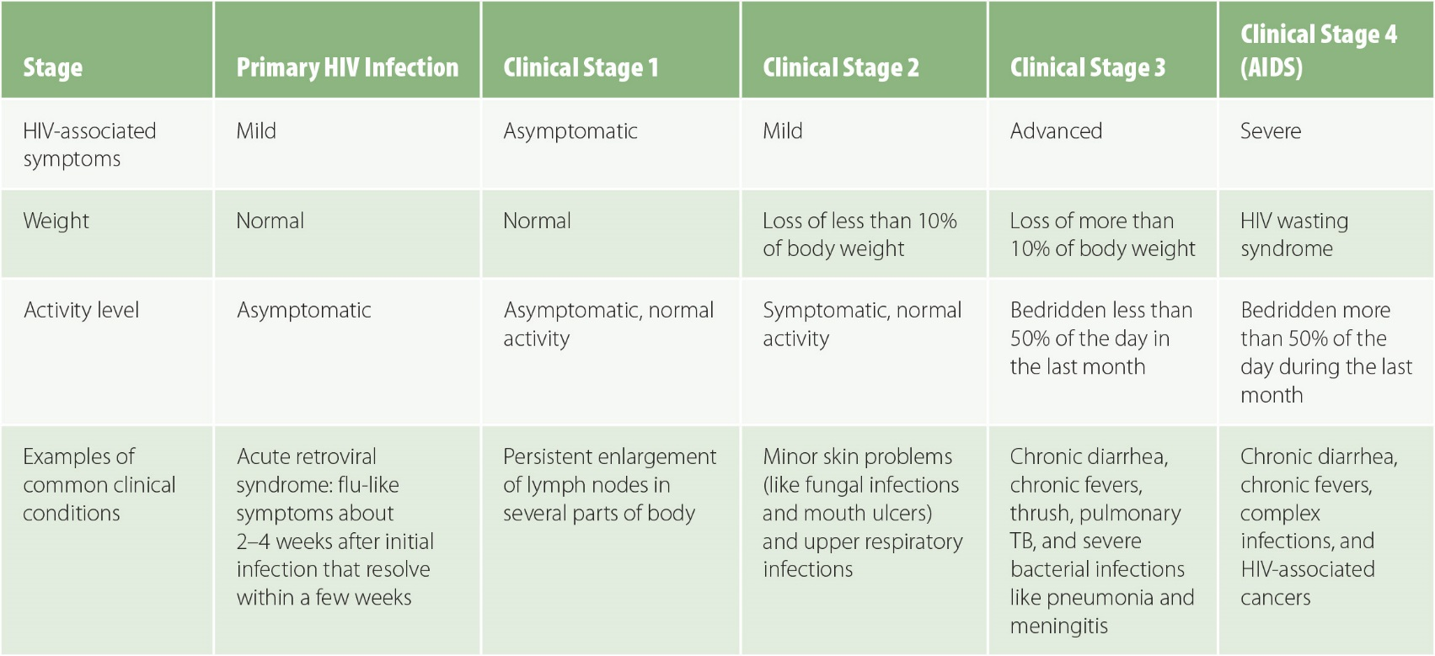
Figure 8-4
Data from WHO case definitions of HIV for surveillance and revised clinical staging and immunological classification of HIV-related disease in adults and children. Geneva: WHO; 2007.
Clinical staging system for HIV/AIDS.

Slide 15
Treatment
Antiretroviral (ARV) drugs keep the viral count low and slow the progression of symptoms.
Antiretroviral therapy (ART), also called highly active antiretroviral therapy (HAART), uses combinations (sometimes called “cocktails”) of three or more different drugs to combat HIV.
  Nucleoside reverse transcriptase inhibitors (NRTIs), such as tenofovir, lamivudine, abacavir, emtricitabine, and zidovudine (AZT)
  Non-nucleoside reverse transcriptase inhibitors (NNRTIs), such as efavirenz and nevirapine
  Protease inhibitors, such as lopinavir, ritonavir, and darunavir
  Integrase inhibitors
There is currently no HIV vaccine and no drug that can cure an HIV infection.

Slide 16
Treatment (cont’d)
Natural history of disease = the usual timeline from initial infection with a particular agent to either recovery or death.
The median survival time after infection with HIV if a person does not take ART is about 10 years, including an average of 2 years of survival from onset of clinical AIDS to death.
ART prolongs both the duration of time between infection and the onset of clinical AIDS and the time between onset of AIDS and death.
WHO recommends beginning ART immediately after diagnosis.
  Prophylactic doses of co-trimoxazole is recommended for people with advanced HIV to reduce the risk of OIs.
  Isoniazid can be used as preventive treatment in people at risk of TB.

Slide 17
HIV/AIDS Epidemiology
8.4

Slide 18
HIV History
1920s: Likely occurrence of the first cases of HIV in humans, in what is now the Democratic Republic of the Congo (DRC)
1981: The first cases of AIDS were diagnosed when clusters of homosexual men in the United States were diagnosed with PCP fungal pneumonia and Kaposi’s sarcoma
1990: Nearly 10 million people living with HIV (PLHIV)
Mid-1990s: 20 million PLHIV
2005: More than 30 million PLHIV
2015: 37 million PLHIV

Slide 19
HIV Prevalence
The increase in the number of prevalent HIV cases is a public health success, because the increase in the number of people living with HIV has occurred as a result of the mortality rate decreasing.
The eventual goal is for the prevalence rate to gradually decrease as people with HIV age and die of diseases not related to HIV infection.

Slide 20
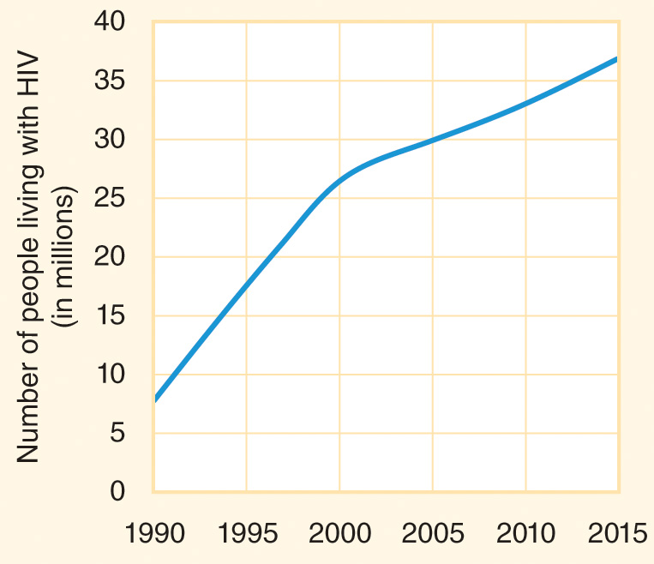
Figure 8-5
Data from GBD 2015 HIV Collaborators. Estimates of global, regional, and national incidence, prevalence, and mortality of HIV, 1980–2015: The Global Burden of Disease Study 2015. Lancet HIV 2016; 3:e361-87.
HIV prevalence: the number of people living with HIV worldwide has increased.

Slide 21
HIV Incidence
The number of new HIV infections each year decreased to about 2 million per year after 2010 from a peak above 3 million per year at the turn of the century.
Little progress has been made toward the goal of reducing the annual number of incident cases to below 500,000 by 2020 and below 200,000 by 2030.

Slide 22
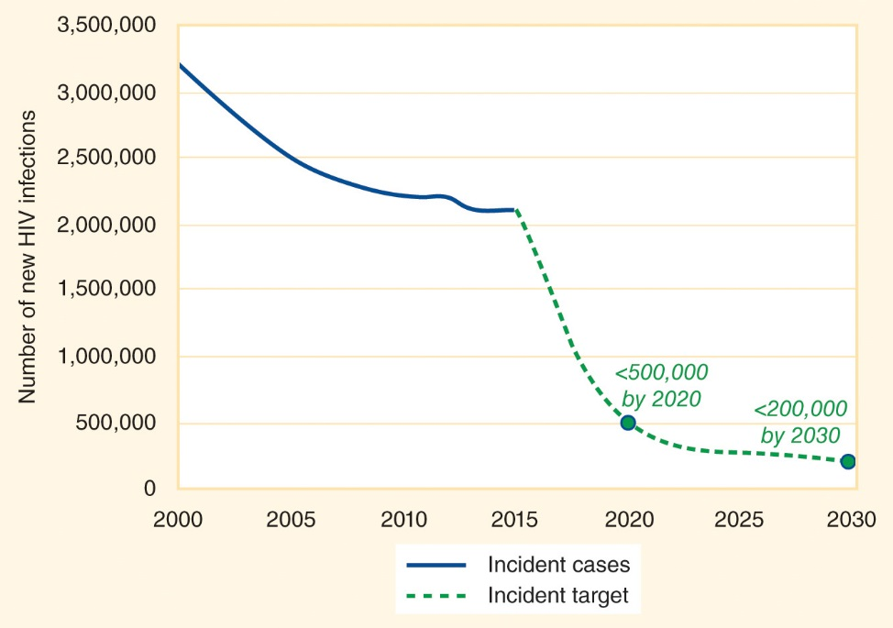
Figure 8-6
Data from AIDS by the numbers 2016. Geneva: UNAIDS; 2016.
HIV incidence: The number of new HIV infections each year has stabilized rather than continuing to decrease.

Slide 23
HIV Mortality
As of 2015, progress was being made toward the goal of reducing the annual number of HIV/AIDS deaths to below 500,000 by 2020 and below 200,000 by 2030.

Slide 24
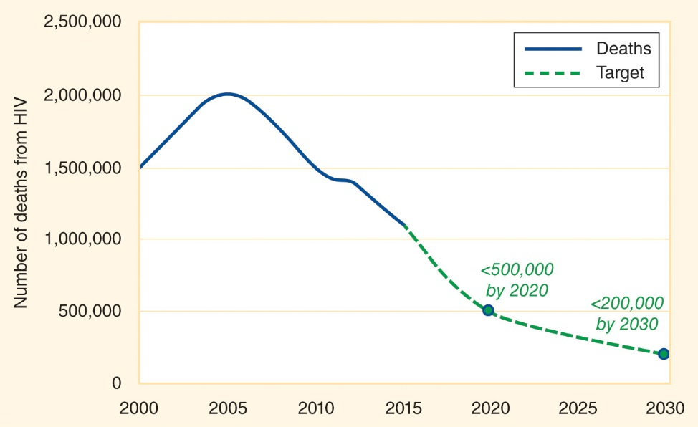
Figure 8-7
Data from AIDS by the numbers 2016. Geneva: UNAIDS; 2016.
HIV mortality: The number of deaths from HIV each year has decreased as more people gain access to ART.

Slide 25
HIV in Featured Countries
About 1 in 200 people worldwide (across all ages) has HIV infection.
About 1 in 50 people who died in 2015 died from HIV/AIDS.
  Proportionate mortality rate = the percentage of all people who died who died from a particular cause.
Access to ART is increasing in most countries.

Slide 26
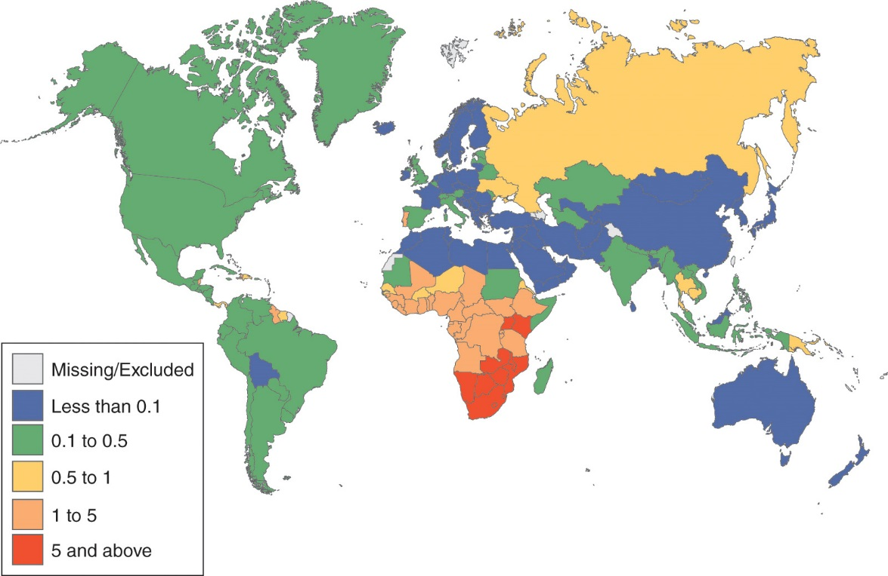
Figure 8-8
Data from GBD 2015 HIV Collaborators. Estimates of global, regional, and national incidence, prevalence, and mortality of HIV, 1980–2015: The Global Burden of Disease Study 2015. Lancet HIV 2016; 3:e361-87.
Prevalence of HIV among people 15-49 years old (2015).

Slide 27
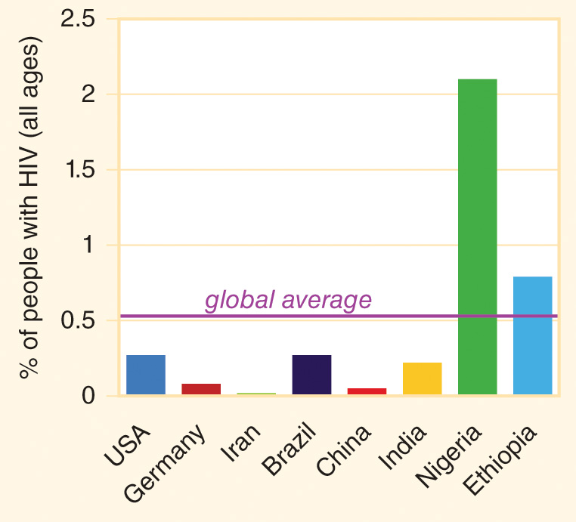
Figure 8-9
Data from GBD 2015 HIV Collaborators. Estimates of global, regional, and national incidence, prevalence, and mortality of HIV, 1980–2015: The Global Burden of Disease Study 2015. Lancet HIV 2016; 3:e361-87.
HIV prevalence: Percentage of people (all ages) living with HIV in featured countries in 2015.

Slide 28
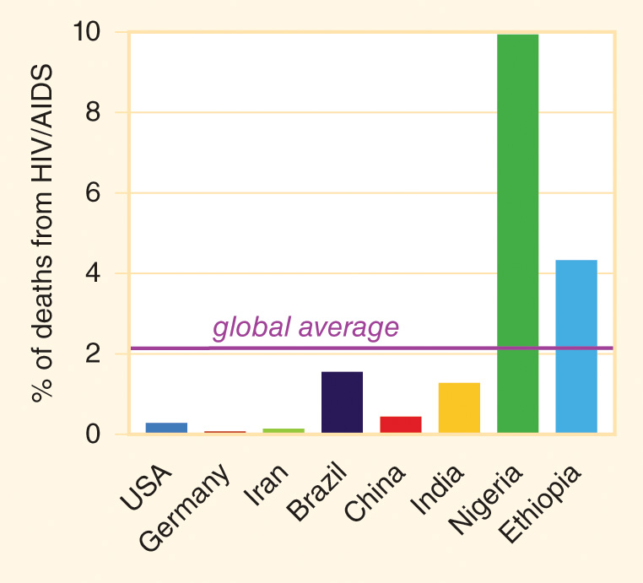
Figure 8-10
Data from GBD 2015 HIV Collaborators. Estimates of global, regional, and national incidence, prevalence, and mortality of HIV, 1980–2015: The Global Burden of Disease Study 2015. Lancet HIV 2016; 3:e361-87.
HIV mortality: percentage of total deaths (all ages) due to HIV/AIDS in featured countries in 2015.

Slide 29
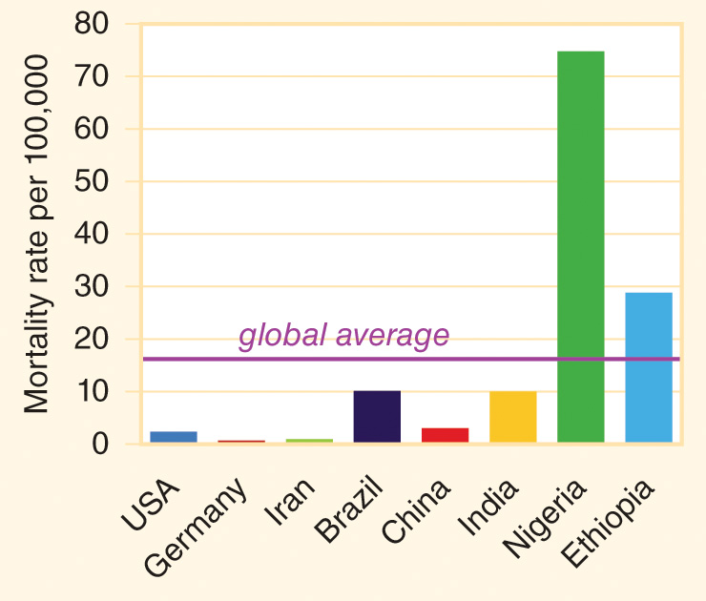
Figure 8-11
Data from GBD 2015 HIV Collaborators. Estimates of global, regional, and national incidence, prevalence, and mortality of HIV, 1980–2015: The Global Burden of Disease Study 2015. Lancet HIV 2016; 3:e361-87.
HIV mortality: HIV death rates per 100,000 people (all ages) in featured countries in 2015.

Slide 30
HIV and Women
Women are at least twice as likely as men to acquire HIV from an act of heterosexual intercourse.
Women generally marry at younger ages than men and are more likely than men to be the victims of sexual violence.
More than half of the prevalent cases of HIV and half of new cases of HIV worldwide occur in females.
Women tend to become infected with HIV at younger ages than men.

Slide 31
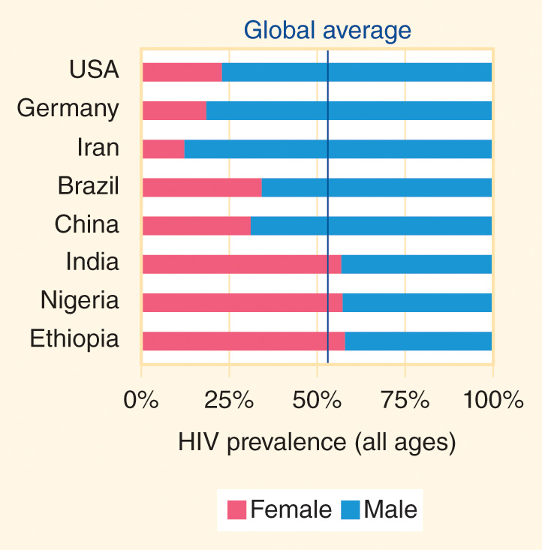
Figure 8-12
Data from GBD 2015 HIV Collaborators. Estimates of global, regional, and national incidence, prevalence, and mortality of HIV, 1980–2015: The Global Burden of Disease Study 2015. Lancet HIV 2016; 3:e361-87.
HIV prevalence: Percentage of people living with HIV in featured countries in 2015 who were female.

Slide 32
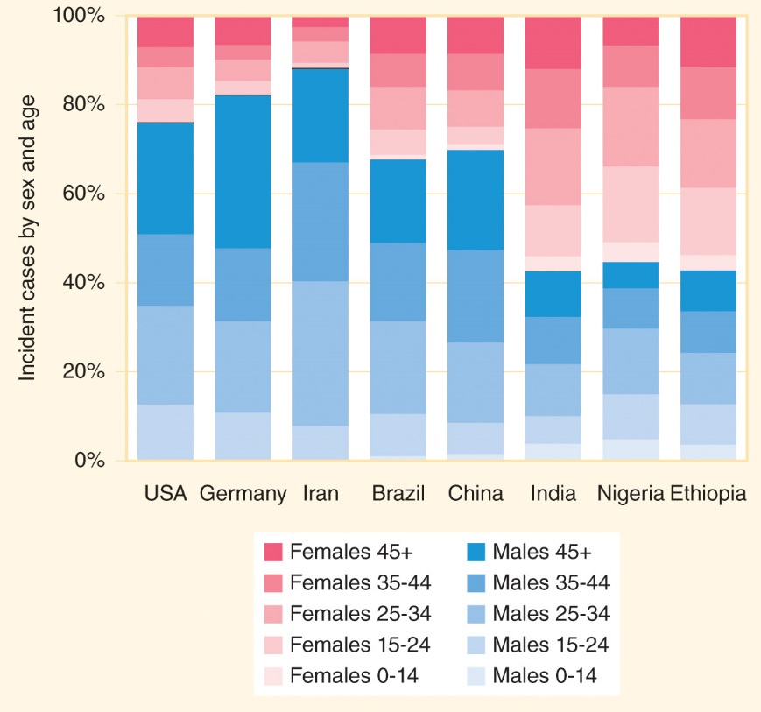
Figure 8-13
Data from GBD 2015 HIV Collaborators. Estimates of global, regional, and national incidence, prevalence, and mortality of HIV, 1980–2015: The Global Burden of Disease Study 2015. Lancet HIV 2016; 3:e361-87.
HIV incidence: Percentage of new cases by age and sex in featured countries in 2015.

Slide 33
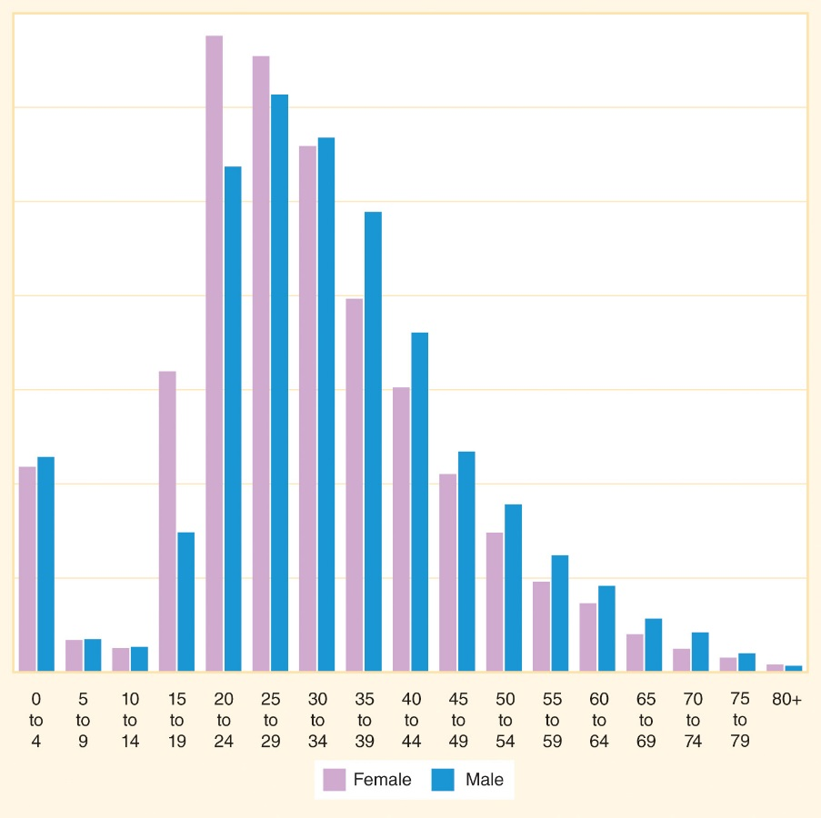
Figure 8-14
Data from GBD 2015 HIV Collaborators. Estimates of global, regional, and national incidence, prevalence, and mortality of HIV, 1980–2015: The Global Burden of Disease Study 2015. Lancet HIV 2016; 3:e361-87.
HIV incidence: The peak incidence occurs at younger ages for females than for males.

Slide 34
Key Populations
Men who have sex with men (MSM)
People who inject drugs (PWID)
People in prison or other criminal justice detention centers
Sex workers
Transgender people

Slide 35
HIV Interventions
8.5

Slide 36
Voluntary Counseling and Testing
Voluntary counseling and testing (VCT) = a process of pre-test counseling about risk assessment, the testing process, and planned prevention and coping strategies; performance of an HIV test, typically using a rapid diagnostic test of blood or oral fluids; receipt of test results; and post-test counseling about risk reduction and disclosure of HIV status.

Slide 37
Antiretrovirals (ARVs)
The reduced HIV mortality rate is a direct function of increased access to ARVs.
The “15 by 15” goal of 15 million people taking ART daily by 2015 was achieved.
An acceleration in the scale-up of ART programs will be necessary to meet the “90–90–90” goal of having at least 90% of people with HIV infection know their status, at least 90% of people with diagnosed HIV taking ART, and at least 90% of people on ART achieving viral suppression by 2020.

Slide 38
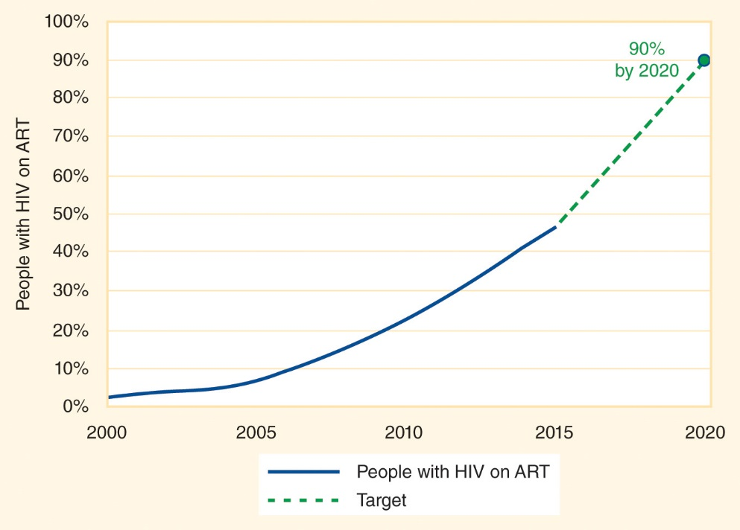
Figure 8-15
Data from AIDS by the numbers 2016. Geneva: UNAIDS; 2016.
HIV treatment: The percentage of people with HIV taking ART has increased rapidly.

Slide 39
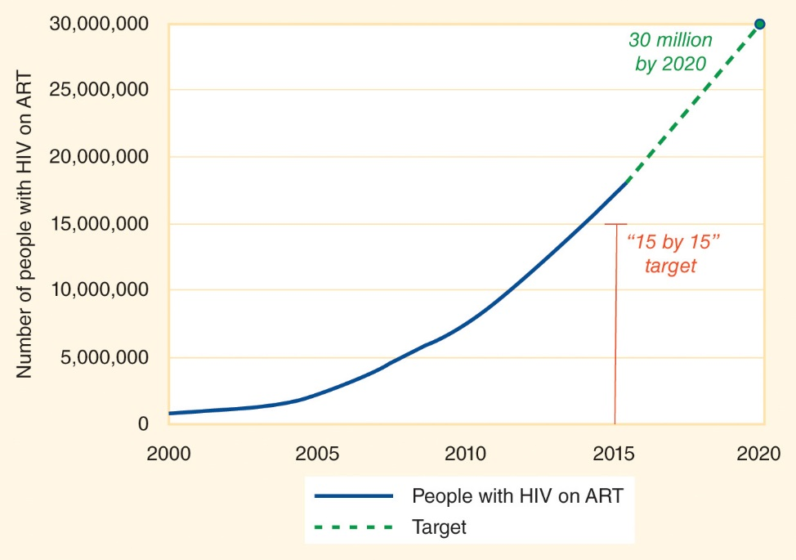
Figure 8-16
Data from AIDS by the numbers 2016. Geneva: UNAIDS; 2016.
HIV treatment: The number of people with HIV taking ART has increased rapidly.

Slide 40
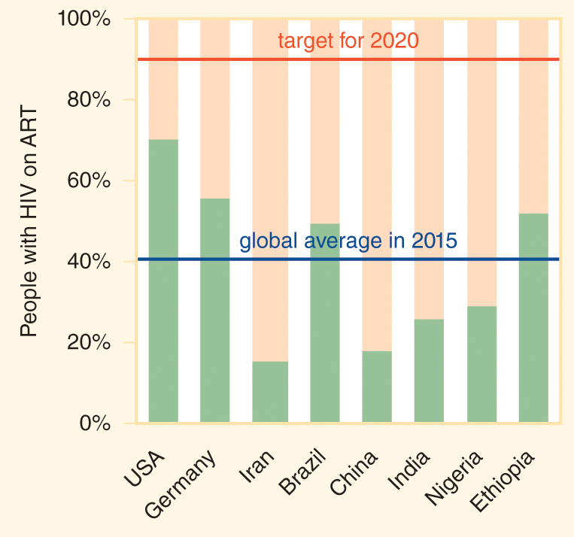
Figure 8-17
Data from GBD 2015 HIV Collaborators. Estimates of global, regional, and national incidence, prevalence, and mortality of HIV, 1980–2015: The Global Burden of Disease Study 2015. Lancet HIV 2016; 3:e361-87.
HIV treatment: ART use in featured countries in 2015.

Slide 41
Prevention of MTCT (PMTCT)
Mother to child transmission (MTCT) = vertical transmission = transmission of HIV from a pregnant women to her offspring during pregnancy, delivery, or breastfeeding.
  In the absence of any drug interventions, a baby born to an HIV-infected mother has about a 15% to 30% risk of contracting HIV during delivery.
  If the infant is breastfed for several months, the cumulative risk can be as high as 25% to 45%.
  If the mother takes ARVs, the likelihood of transmission is only about 1% or 2%.

Slide 42
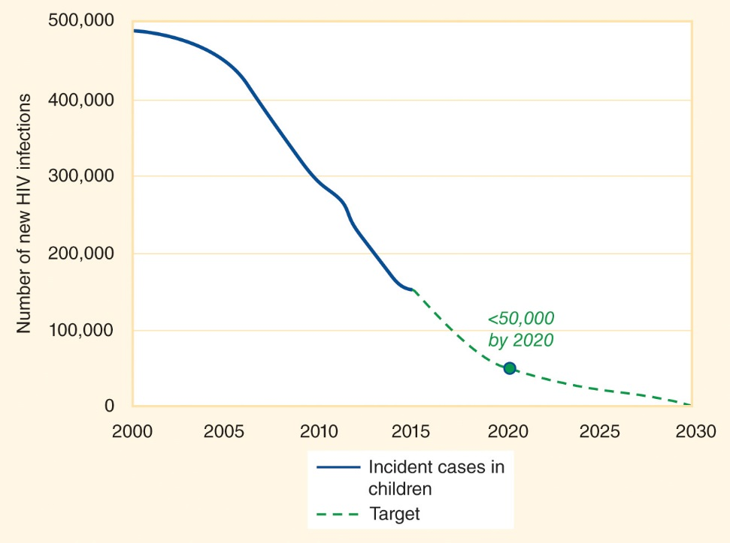
Figure 8-18
Data from AIDS by the numbers 2016. Geneva: UNAIDS; 2016.
HIV incidence: The number of new HIV infections each year among children has decreased.

Slide 43
ARVs and Prevention
Treatment of people with HIV is a critical part of prevention strategies.
Post-exposure prophylaxis (PEP) = taking ARVs after exposure to HIV in order to reduce the likelihood of contracting an infection.
Pre-exposure prophylaxis (PrEP) = taking ARVs prior to a likely exposure to HIV in order to reduce the likelihood of contracting an infection.

Slide 44
HIV Prevention
Use of ARVs (treatment, PEP, PrEP)
Universal precautions
ABCs (abstinence, be faithful, condom use)
Treatment of other sexually transmitted infections
Voluntary male medical circumcision (VMMC) in countries with high levels of HIV transmission
Needle exchanges for injecting drug users

Slide 45
HIV Financing
Low- and middle-income countries (LMICs) are paying an increasing share of the costs of HIV prevention and treatment programs in their countries, reaching nearly $11 billion by 2015.
In 2015, the governments of high-income countries invested about $7.5 billion in HIV/AIDS programs in LMICs (~75% bilateral + ~25% multilateral spending distributed through the Global Fund, Unitaid, and other partnerships).
Private-sector donations to HIV/AIDS programs in LMICs exceeded $600 million in 2015, with the Bill & Melinda Gates Foundation the largest donor.
The United States is the largest funder of HIV programs in LMICs in terms of dollars spent each year.
PEPFAR = the U.S. President’s Emergency Plan for AIDS Relief.

Slide 46
Other Sexually Transmitted Infections (STIs)
8.7

Slide 47
Other STIs
Sexually transmitted infection (STI) = an infection spread through sexual intercourse or other types of sexual contact.
STIs are often asymptomatic; when symptoms of an STI are present, the affected individual is considered to have a sexually transmitted disease (STD), also called a venereal disease.
Examples: chlamydia, gonorrhea, syphilis, herpes, HPV, trichomoniasis.

Slide 48
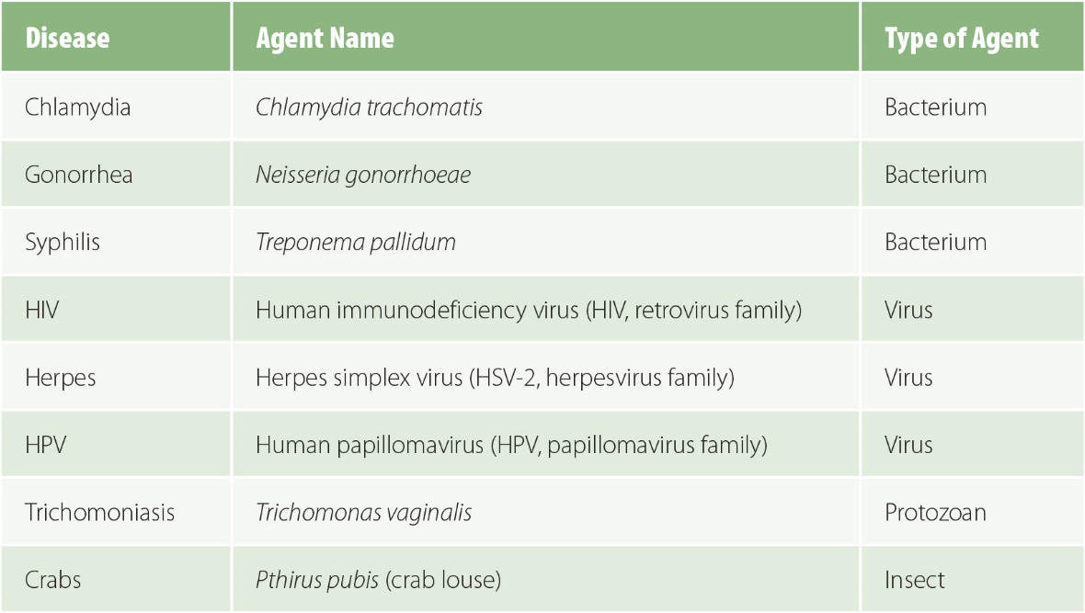
Figure 8-19
Examples of sexually-transmitted infections (STIs).

Slide 49
Other STIs (cont’d)
Partner notification = the process of a patient diagnosed with an STI or a public health official communicating with the sexual partners of the diagnosed individual about their need to be tested so that they can receive appropriate treatment, if necessary, and they can take steps to protect the health of future partners.

Slide 50
Tuberculosis
8.7

Slide 51
Tuberculosis (TB)
Caused by the bacterium Mycobacterium tuberculosis
Spread through airborne droplets
Usually affects the lungs (pulmonary TB)

Slide 52
Infection and Disease
Infection occurs when an infectious agent begins to reproduce inside a person.
  Latent phase = incubation period = a time period when the infectious agent multiplies in the host but the infected individual does not feel sick.
  For TB, this stage is called latent TB infection (LTBI).
  LTBI may persist for decades.
  About one in three people worldwide has been infected with the TB bacillus.
Disease occurs when an infected person develops symptoms and becomes ill.
  Not all infections cause disease.
  When LTBI converts into a symptomatic, contagious form, it is called TB disease = active TB.
  Only about 5% to 15% of people with LTBI develop TB disease during their lifetimes.

Slide 53
TB Diagnosis
Purified protein derivative (PPD) test = Mantoux tuberculin skin test (TST) = a small amount of TB bacterial protein is injected under the skin and the reaction is monitored.
  BCG (Bacillus Calmette-Guérin) is a TB vaccine used in many countries to confer some protection against TB disease (not infection) in children, but it can cause a false-positive PPD test.
Interferon-gamma release assay (IGRA) blood test.
Chest x-ray to look for lesions that might be pockets of TB infection.
Sputum smear test is conducted on the phlegm produced by deep coughs.

Slide 54
TB Interventions
8.8

Slide 55
TB Treatment
The standard treatment regimen for TB involves taking a combination of up to five different drugs (isoniazid, rifampicin, pyrazinamide, ethambutol, and streptomycin) every day for 6 months or longer.
DOTS (directly observed therapy, short-course) = a trained observer watches patients take their pills every day to ensure compliance.
Case detection rate = the proportion of people with TB disease who are diagnosed.
A low CDR means that many people who should take DOTS for TB are not undergoing treatment.

Slide 56
Global TB Strategy
Stop TB Strategy (2006–2015) led by the World Health Organization (WHO) spelled out a plan for achieving the Millennium Development Goals (MDGs) target for TB.
  Between 2000 and 2015, there was a 42% reduction in overall prevalence of TB disease and a 47% reduction in mortality among people without HIV infection.
End TB Strategy (2016–2035) supports the achievement of the Sustainable Development Goals (SDGs).
  Reduce TB incidence by 80% and TB deaths by 90% between 2015 and 2030.
  Further reduce these rates, to 90% and 95%, respectively, by 2035.

Slide 57
End TB Strategy
In 2015, there were an estimated 10.4 million new cases of TB disease worldwide, an incidence rate of 142 per 100,000 people.
  Six populous countries were home to 60% of the world’s TB cases: India, Indonesia, China, Nigeria, Pakistan, and South Africa.
  The End TB Strategy aims to reduce the global incidence rate to 10 new cases per 100,000 people per year by 2035.
In 2015, 1.4 million people died from TB, a global mortality rate of 24 per 100,000 people in 2015.
  The End TB Strategy aims to reduce the global TB mortality rate by 95% between 2015 and 2035.

Slide 58
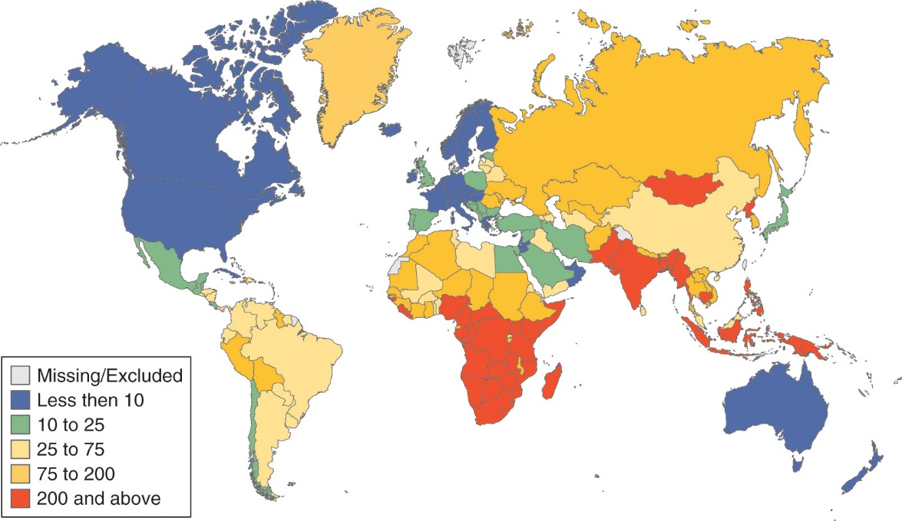
Figure 8-20
Data from Global tuberculosis report 2016. Geneva: WHO; 2016.
Incidence of new cases of TB disease per 100,000 people (2015).

Slide 59
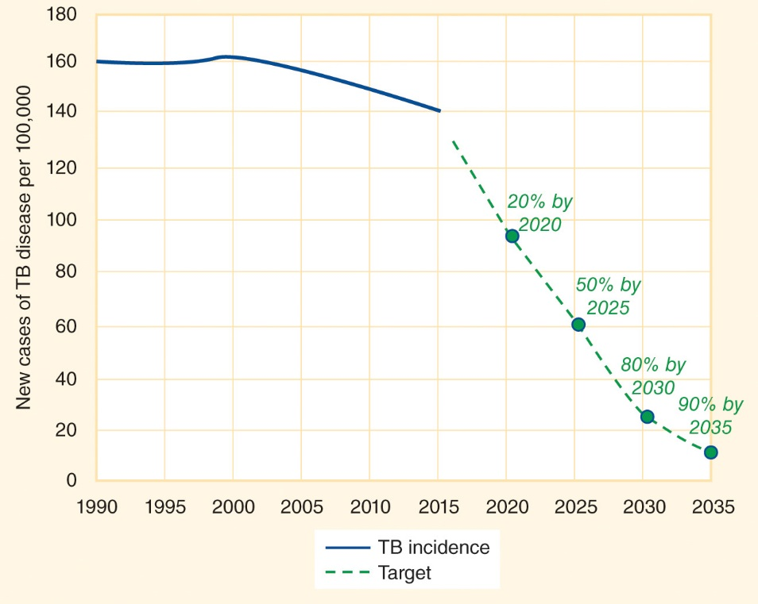
Figure 8-21
Data from Global tuberculosis report 2016. Geneva: WHO; 2016.
TB incidence: Approximate targets for reduction of the TB incidence rate.

Slide 60
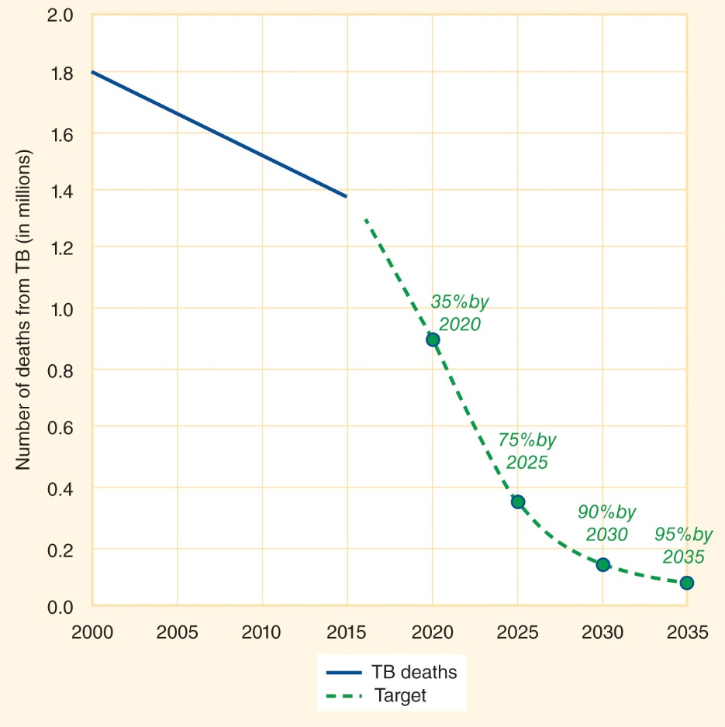
Figure 8-22
Data from Global tuberculosis report 2016. Geneva: WHO; 2016.
TB mortality: Approximate targets for reduction in the number of TB deaths (not including death from TB/HIV co-infection).

Slide 61
HIV/TB Coinfection
HIV treatment programs are an important contributor to TB control.
People with HIV infection are about 30 times more likely to develop active TB disease than people without HIV infection.
  In 2015, 1.2 million (11%) of the 10.4 million incident cases of TB disease worldwide occurred in people with HIV.
TB is the leading cause of death for people with HIV; in 2015, about one in three people who died from HIV/AIDS died as a result of TB infection.
  In 2015 there were about 390,000 people with HIV who died from TB in addition to the 1.4 million TB deaths in people without HIV.
People with an HIV infection can be successfully treated for TB.

Slide 62
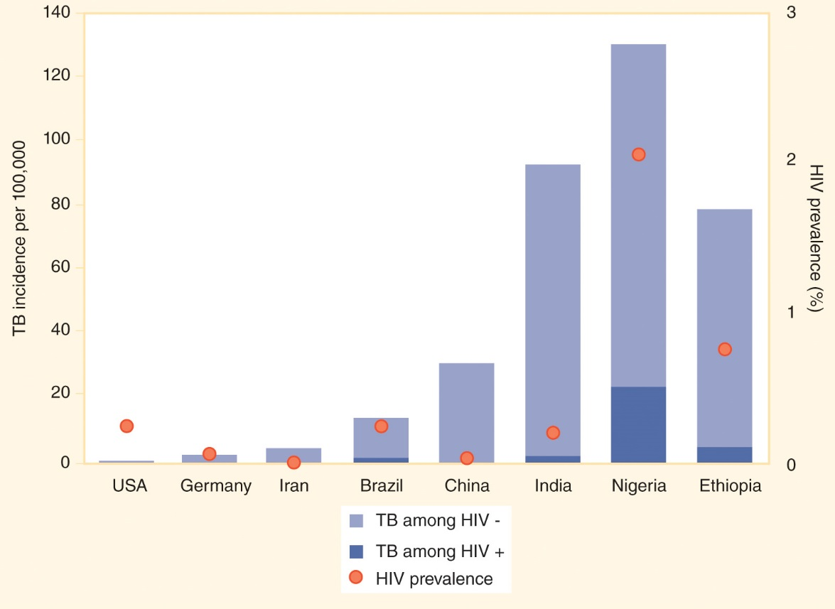
Figure 8-23
Data from Global tuberculosis report 2016. Geneva: WHO; 2016.
TB incidence: New cases of TB disease per 100,000 residents in 2015.

Slide 63
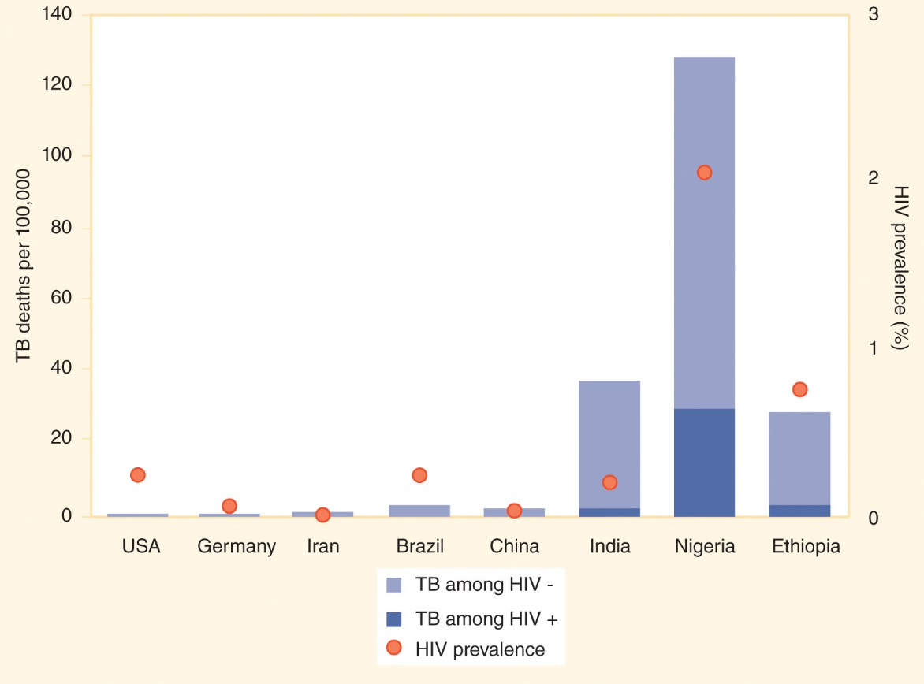
Figure 8-24
Data from Global tuberculosis report 2016. Geneva: WHO; 2016.
TB mortality: Deaths per 100,000 residents in 2015 (including cases among people with HIV infection).

Slide 64
Antimicrobial Resistance
8.9

Slide 65
Antimicrobial Resistance (AMR)
Antimicrobial resistance (AMR) = drug resistance.
  A pathogen is sensitive to a drug if it is vulnerable to it.
  A pathogen is resistant to a drug if it can withstand treatment with it.
AMR occurs when a pathogen that used to be susceptible to a particular type of drug mutates in a way that makes the drug ineffective.
The misuse and overuse of antibiotics are driving the development of AMR.

Slide 66
Multidrug-Resistant TB
Drug-resistant TB (DR-TB) is a growing global health problem.
  The default rate, the proportion of people who are diagnosed but do not complete the full course of treatment, is high in some places.
Multidrug-resistant TB (MDR-TB) is a TB strain that does not respond to two of the standard antibiotic therapies, rifampicin and isoniazid.
  In 2015, about 3.9% of new cases of TB and 21% of previously treated cases were MDR-TB or rifampicin-resistant TB (RR-TB), but in some countries and regions the proportion is much higher.
Extensively drug-resistant TB (XDR-TB) is resistant to rifampicin, isoniazid, fluoroquinolones, and at least one second-line injectable TB drug.

Slide 67
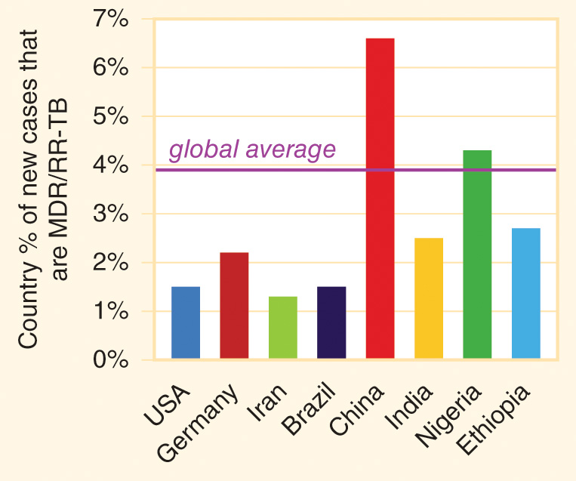
Figure 8-25
Data from Global tuberculosis report 2016. Geneva: WHO; 2016.
Percentage of new TB cases in 2015 that were multidrug-resistant (MDR-TB) and/or rifampicin-resistant (RR-TB).

Slide 68
Healthcare-Associated Infection
A healthcare-associated infection (HAI) = a nosocomial infection = a hospital-acquired infection = an infection that is contracted while receiving care in a hospital, nursing or rehabilitation center, or other medical facility.
Some HAIs are drug resistant, such as MRSA (methicillin-resistant Staphylococcus aureus).
Antimicrobial stewardship programs that ensure that patients are prescribed the right drug at the right dose for the right duration and through the right route serve to limit the risk of adverse outcomes of HAIs, including drug-resistant infections.
A new “superbug” that evolves anywhere in the world poses a threat to the whole world.

